Slide 1
Chapter 1 Introduction to Ubiquitous Computing
Dr. Nilesh Madhukar Patil
Associate Professor
Computer Engineering Department

Slide 2
Topics to be covered…
Impact of digital world
Illustrative applications
Modelling the Key Ubiquitous Computing Properties
Ubiquitous System Environment Interaction
Architectural Design for Ubiquitous Computing Systems

Slide 3
Ubiquitous Computing (1/3)
The word “ubiquitous” can be defined as “existing or being everywhere at the same time,” “constantly encountered,” and “widespread.”
When applying this concept to technology, the term ubiquitous implies that technology is everywhere and we use it all the time.
Ubiquitous computing (ubicomp) is a post-desktop model of human-computer interaction in which information processing has been thoroughly integrated into everyday objects and activities.

Slide 4
Ubiquitous Computing (2/3)
Also called Pervasive Computing, Ambient Intelligence or everyware.
The concept of ubiquitous computing dates back to the late 1980s.
The phrase "ubiquitous computing" was coined by Mark Weiser, who worked as the Chief Technologist at Xerox PARC (Palo Alto Research Center) in 1988.
He outlined this vision in a seminal paper titled "The Computer for the 21st Century," published in 1991.
Weiser's ideas laid the foundation for a paradigm shift in computing, moving away from the traditional model of personal computing to a more integrated and pervasive approach.

Slide 5
Ubiquitous Computing (3/3)
“Ubiquitous computing is a concept in software engineering and computer science where computing is made to appear anytime and everywhere. In contrast to desktop computing, ubiquitous computing can occur using any device, in any location, and in any format.”
--- Wikipedia
Ubiquitous computing is a “Seamless integration of technology into everyday objects and environments, making them “smart” and capable of interacting with users and other devices without explicit human intervention”.

Slide 6
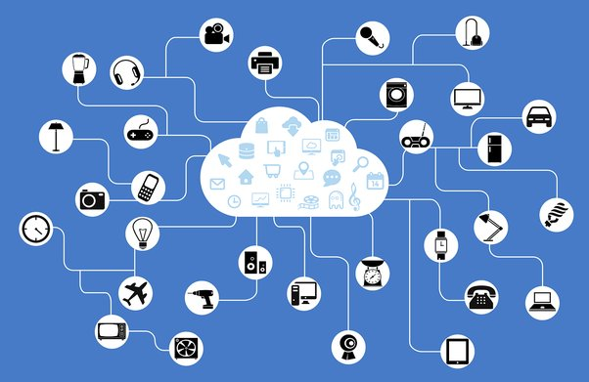
Visual representation of the usage of ubiquitous computing (Collected from Medium)

Slide 7
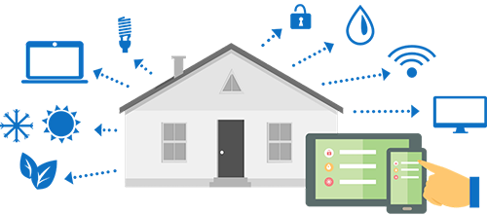
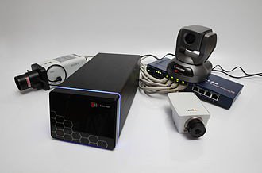
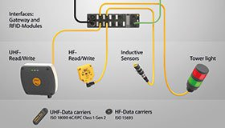
Examples of Ubiquitous Computing (1/2)
Home Automation IP Camera RFID Devices
Notes:
EXAMPLES OF UBIQUITOUS COMPUTING APPLICATIONS
Home Automation: In this era of computing, we all heard the concept of “Home Automation”. In this process, we connect all possible devices to a LAN (Local Area Network) or directly to the internet. We use a parent device (Example: Amazon Alexa, Google Home, Apple Hub) to give the command to those devices. To imply this concept we give computing power to all connected devices. In this situation, we use ubiquitous computing.
IP camera: Nowadays consumer electronic devices are being networked. Some high-end cameras already have a wireless network capability and use it to send photos and videos to a nearby display or to upload those data to the internet. “An Internet Protocol camera, or IP camera, is a type of digital video camera that receives control data and sends image data via the Internet”.
RFID Devices: RFID stands for Radio Frequency Identification. RFID tags are passive of stamps which can communicate with RFID readers. We are using RFID chips massively in Credit or Debit cards to store our financial data in an encrypted format.
Smartphones: They are the most obvious and immediate example, since more often than not, one can just download an app and through it control their home automation systems and other ubiquitous applications.
Wearables: Wearables like smart watches , smart glasses etc. are examples of ubiquitous computing Be it Apple watch or Fitbit, both come under ubiquitous computing.
Self-driving vehicles: self-driving cars Also good examples of ubiquitous computing experience. In fact, an autonomous vehicle that can identify its authorized passenger through smartphone proximity, dock and charge itself when needed, and handle toll, emergency response, and fast-food payments itself by communicating with infrastructure would make for an even better instance of ubiquitous computing.

Slide 8
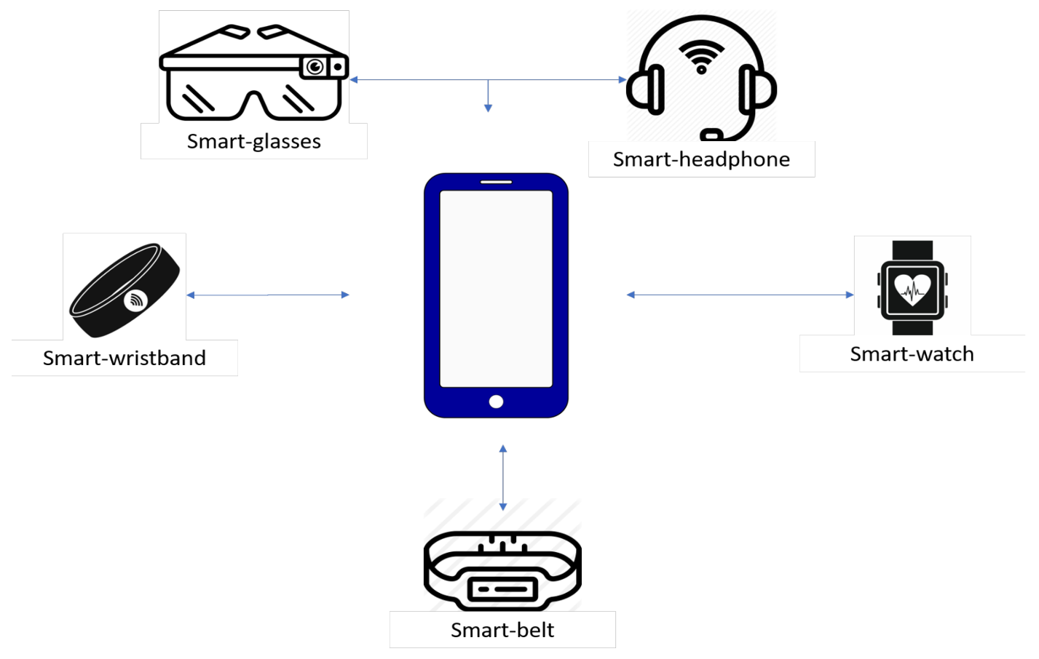
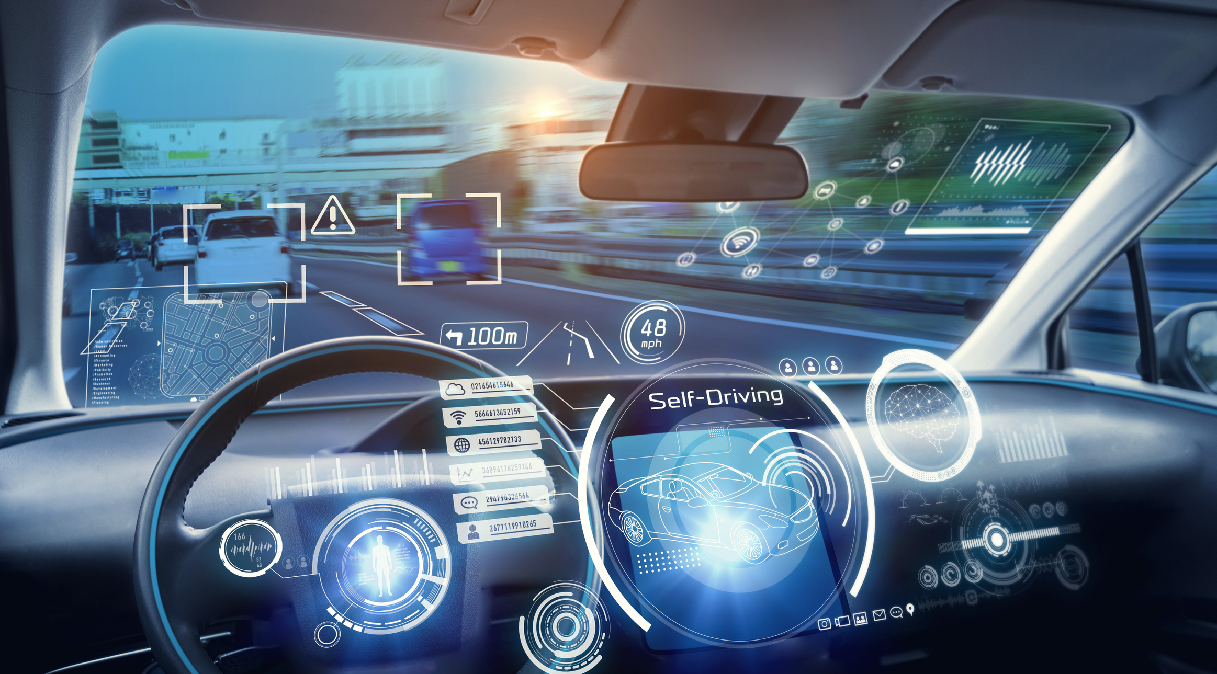
Examples of Ubiquitous Computing (2/2)
Wearables Self-driving Car

Slide 9
Impact of Digital World
Digital world populated by digital devices
Assigned to automate human tasks & activities
Enrich human social interaction
Enrich physical world interaction
The physical world is often referred to as the real world or environment in order to distinguish this both from a perceived human view of the world (imaginary worlds) not related to reality and basic facts and from computer generated views of the world (virtual worlds).
Physical world is having:
Digital instruments
Embedded sensors
Control devices

Slide 10
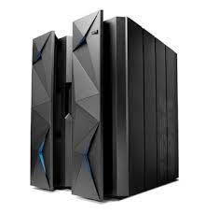
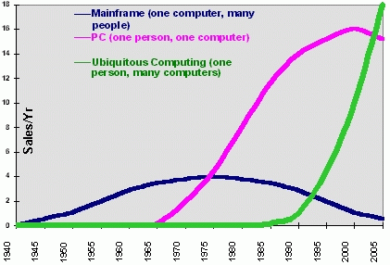
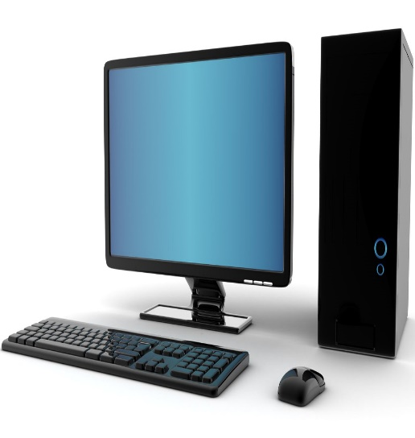
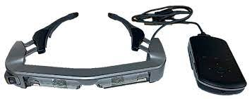
The Major Trends in Computing
Mainframe
Many people, one computer
Fixed, Central location
PC
One person, one computer
Fixed location, decentralized
Ubiquitous
One person, many computers
Mobile

Slide 11
Current Technology Trends in UbiCom
Sensors sensing our locations & adapts it
Positioning systems
epaper & ebooks
Wired & wireless network
Electronic devices & circuits
Smart phones

Slide 12
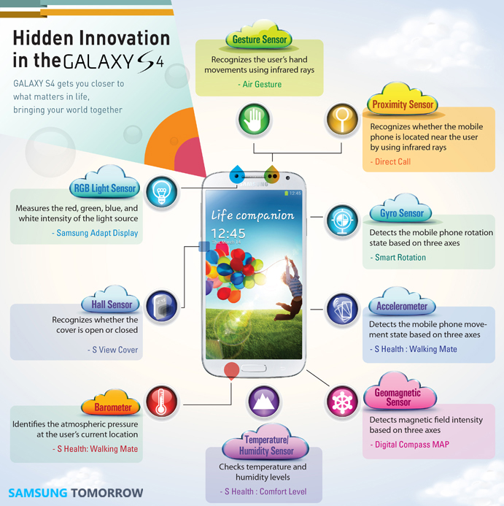
Sensors sensing our locations & adapts it

Slide 13
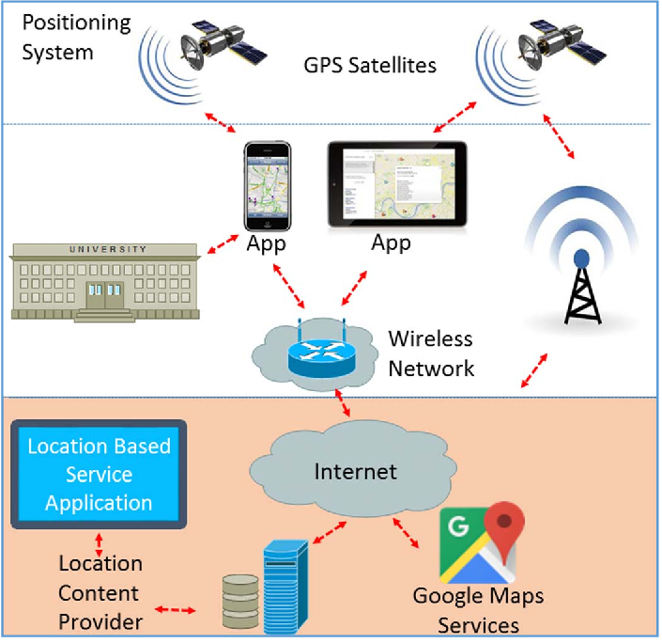
Positioning System

Slide 14
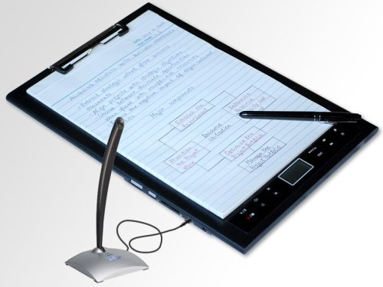
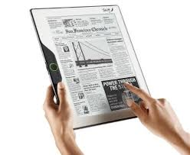
epaper and ebook

Slide 15
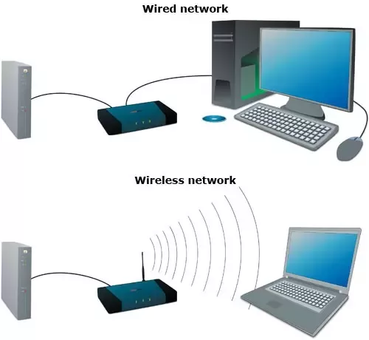
Wired and Wireless Network

Slide 16
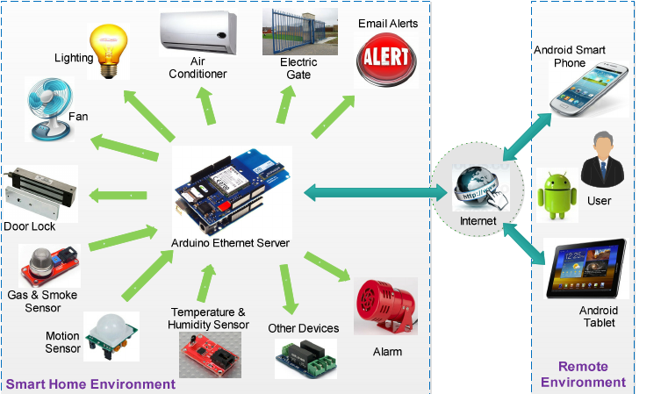
Electronic Devices and Circuits

Slide 17

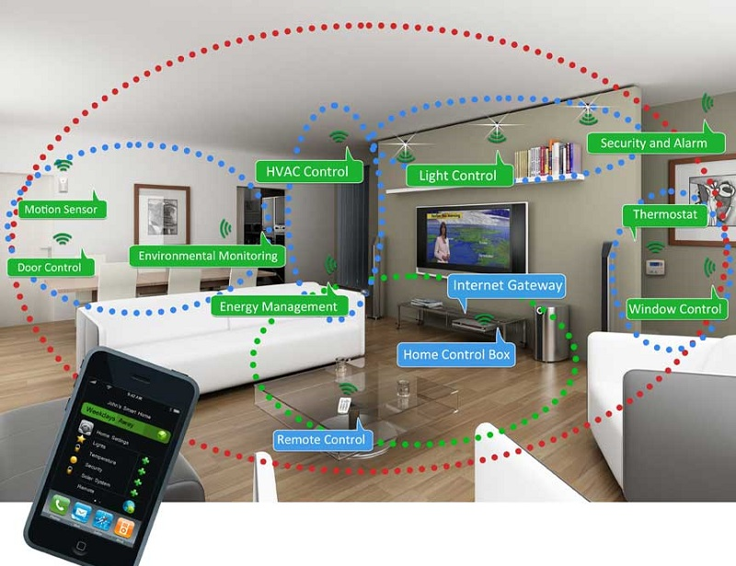
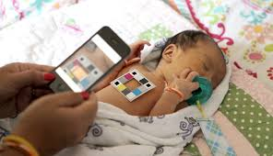
Smart phones

Slide 18
UbiCom Scenarios
4 scenarios illustrate a range of benefits and challenges of ubiquitous computing:
Personal memories
Adaptive Transport Scheduled Service
Foodstuff management
Utility regulation

Slide 19
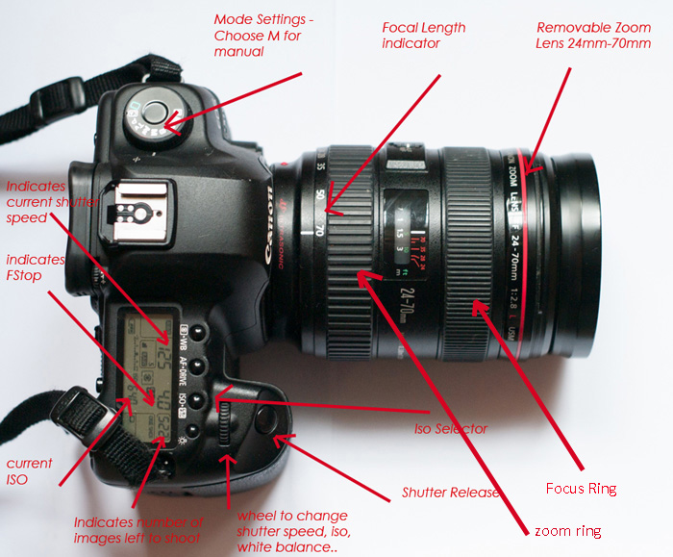
Personal Memories Scenario (1/4)
How we were & we are recording personal memory of physical world ?
Up until about 1980s, photography would entail:
Manual light reading
Setting aperture & camera shutter speed
Manually focusing lenses system
Camera film (with 12 – 36 images) was sequential
Specialist film processing company

Slide 20
Personal Memories Scenario (2/4)
How can we enhance the personal memories service using UbiCom?
Digital Camera:
Automatic capturing on inbuilt display
Context of recording
Modifications
Simple UI
Immediate viewing
AV databases, IP & MEMS can be used.
Has capability to discover specific type of ICT devices

Slide 21
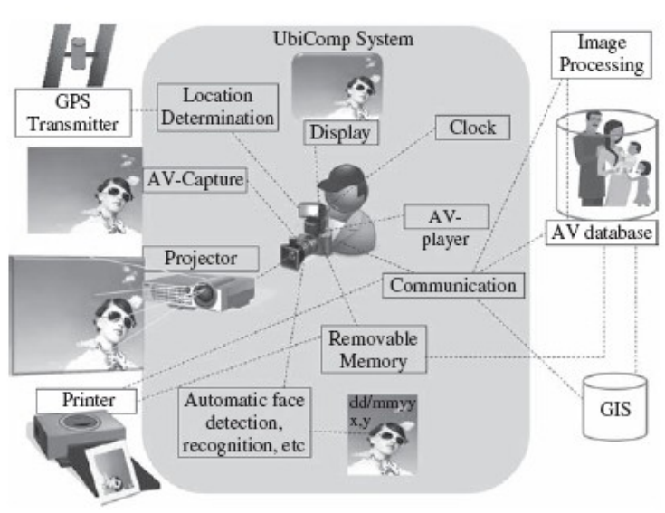
Personal Memories Scenario (3/4)
The AV recording is person aware, location aware (via GPS), time aware and networked to interact with other ICT devices such as printers and a family and friends database.

Slide 22
Personal Memories Scenario (4/4)
Ubiquitous computing encompasses:
wide spectrum of computers,
Multifunction ICT devices like:
Phones, cameras
Game consoles, ATM
Vehicle control system
Mobile phones
Electronic calculators, household appliances

Slide 23
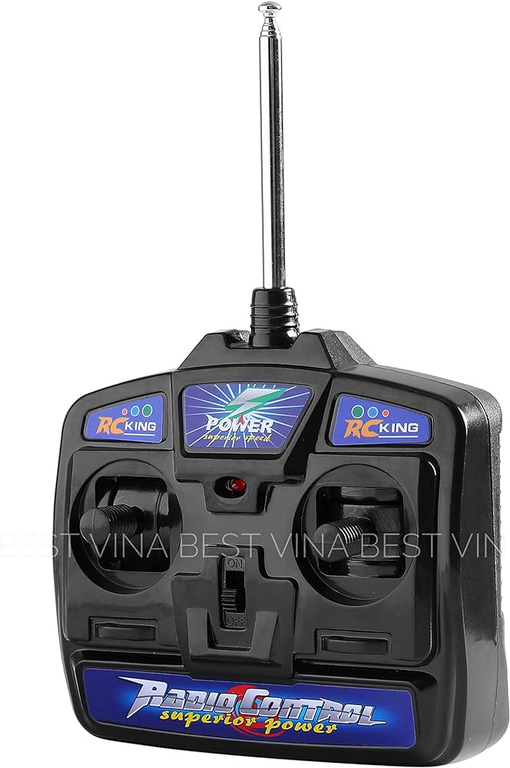
Adaptive Transport Scheduled Service (1/2)
20th century:
Timetables were fixed
Passengers waiting
Vehicle drivers radio in to controller
Controller notify

Slide 24
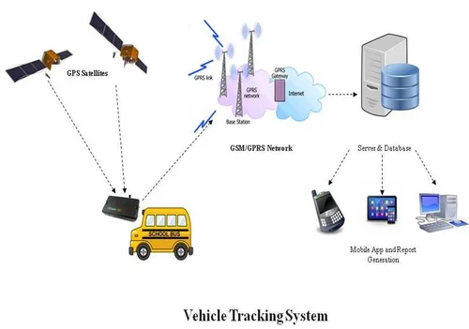
Adaptive Transport Scheduled Service (2/2)
How can we enhance the transport service using UbiCom?
21st century:
Position of vehicle is determined using GPS
Time taken to reach can be estimated
Vehicles on route can tag locations

Slide 25
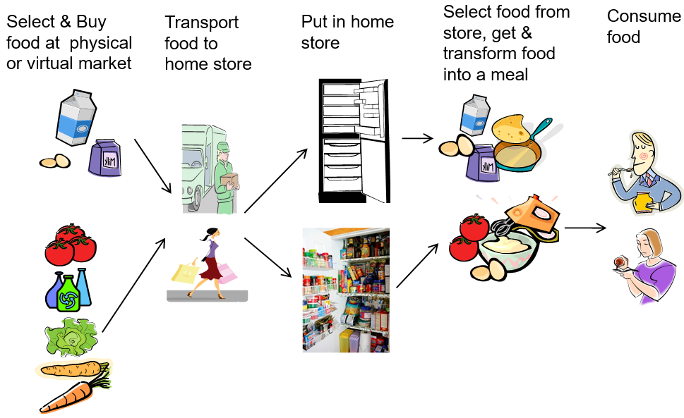
Foodstuff Management Scenario (1/2)

Slide 26
Foodstuff Management Scenario (2/2)
How can UbiCom enhance the foodstuff management scenario?
Ubiquitous home environment is designed to support healthy eating & weight regulation for food consumption.
Consists of networked physical devices
Sensors are integrated in system
Scanners are used to scan
Packaging of food & drinks
Barcodes
Expiry dates
Food ingredients
Percentage by weight

Slide 27
Utility Regulation Service (1/2)
Utility regulation concerns energy, water, waste regulation by end-users.

Slide 28
Utility Regulation Service (2/2)
How can UbiCom enhance the Utility Regulation scenario?
Design user context aware devices
Use multi-agent system and autonomic system models, to operate as a Smart Grid
Advanced utility consumption meters can be used to present the consumption per unit time and per device
A form of demand response system can also be used

Slide 29
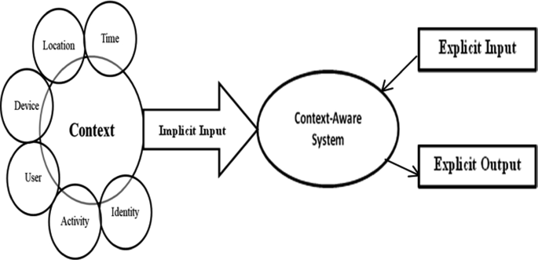
Context-Aware System
Notes:
Explicit Input:
Definition: Explicit input is the information or data that is provided directly and clearly to a system or process.
Example: If you are using a computer, typing a message using a keyboard is an explicit input. The characters you type are explicitly given as input to the system.
Implicit Input:
Definition: Implicit input is information that is not explicitly provided but is inferred or assumed by the system or process.
Example: When you visit a website, your location may be implicitly determined based on your IP address. You may not have directly entered your location, but the system infers it for various purposes, such as providing localized content.
Explicit Output:
Definition: Explicit output is the clear and direct result or information produced by a system or process.
Example: In a calculator application, if you input 2 + 2, the explicit output would be the number 4 displayed on the screen. It is the direct and easily understandable result of the computation.

Slide 30
Modelling the Key Ubiquitous Computing Properties
Core Properties of UbiCom Systems
Distributed System Properties
iHCI System Properties
Context-aware System Properties
Autonomous System Properties
Intelligent System Properties

Slide 31
Core Properties of UbiCom Systems
Computers need to be networked, distributed and transparently accessible
In1991, little wireless computing, Internet far less pervasive
Computer Interaction with Humans needs to be more hidden
Because much HCI is overly intrusive
Computers need to be aware of environment context
In order to optimise their operation in their physical & human environment.
Computers can operate autonomously, without human intervention, be self-governed
Computers can handle a multiplicity of dynamic actions and interactions, governed by intelligent decision-making and intelligent organisational interaction. This entails some form of artificial intelligence.

Slide 32
Distributed System Properties Distributed System, middleware, set of generic services
Property | Explanation
Universal, seamless, heterogeneous | Able to operate across different homogeneous environments, seamless integration of devices and environments, taking on new contexts when new resources become available
Networked | UbiCom devices are interlinked using a network which is often wireless
Synchronised, coordinated | Multiple entity interaction can be coordinated synchronously or asynchronously over time and space interactions
Open | New components can be introduced and accessed, old ones can be modified or retired. Components can be dynamically discovered
Transparent, virtual | Reduces the operational complexity of computing, acting as a single virtual system even although it is physically distributed
Mobile, nomadic | Users, services, data, code and devices may be mobile

Slide 33
iHCI System Properties (1/2) Implicit Human Device Interaction (iHCI)
Property | Explanation
Non intrusive, hidden, invisible, calm computing | ICT is nonintrusive and invisible to the user. It is integrated into the general ecology of the home or workplace and can be used intuitively by users.
Tangible, natural | Interaction is via natural user interfaces and physical artefact interaction that can involve gestures, touch, voice control, eye gaze control, etc.
Anticipatory, speculative, proactive | Improving performance and user experience through anticipated actions and user goals in relation to current context, past user context and group context. This overlaps with user context awareness.
Affective, emotive | Computing that relates to, arises from, or influences human emotions. This is also considered to be a sub type of human intelligence

Slide 34
iHCI System Properties (2/2) Implicit Human Device Interaction (iHCI)
Property | Explanation
User aware | ICT is aware of presence of user, user ID, user characteristics, current user tasks in relation to users’ goals (as part of iHCI and context awareness).
Post human | Sense of being in a world that exists outside ourselves, extending a person’s normal experience across space and time.
Sense of presence immersed, virtual, mediated reality | A person is in a real time interactive environment which experiences an extended sense of presence that combines the virtual and the real, often by overlaying virtual views on real views.

Slide 35
Context-aware System Properties
Property | Explanation
Sentient, unique, localized, situated | Systems can discover and take advantage of the situation or context such as: location, time and user activity. There are three main sub types of context awareness; physical world, user and virtual (ICT) device awareness.
Adaptive, active context aware | Systems actively adapt to context changes in a dynamic environment rather than just present context changes to the user.
Person aware, user aware, personalised, tailored | Tailored to an individual user or type of user, based on personal details or characteristics that a user provides or is gathered about a user. This may trigger system adaptation.
Environment aware, context aware, physical context aware | Sometimes physical world context aware awareness is taken by some researchers to mean general context awareness or general environment awareness. Physical context awareness includes spatial and temporal awareness
ICT awareness | Awareness of ICT infrastructure in which an UbiCom system exists, e.g., awareness of network QoS when transmitting messages

Slide 36
Autonomous System Properties
Property | Explanation
Automatic | Operates without human intervention.
Embedded, encapsulated embodied | System input output and computation is completely encapsulated by, or contained in, the device it controls, e.g., a system that acts as a self contained appliance.
Resource constrained | Systems are designed to be constrained in size to be portable or embeddable; to use constrained computation, data storage, input and output and energy.
Untethered, amorphous | Able to operate independently and proactively, free from external authority, external dependencies are minimized.
Autonomic, self managing, self star | Able to support various self star properties such as self configuring, self healing, self optimising and self protecting behaviour.
Emergent, self organising | More complex behaviour can arise out of multiple simple behaviours.

Slide 37
Intelligent System Properties (1/3)
Property | Explanation
Reactive, reflex | Environment events are sensed. Events then trigger action selection that may lead to actuators changing their environments.
Model based, Rule/ policy based logic/reasoning | Systems use a model of how itself operates and the how the world works. There are many types of model representation such as rule based, different types of logic based, etc.
Goal oriented, planned, proactive | User goals can be used to plan actions dynamically rather than pre programmed actions.
Utility based, game theoretic | Systems can be designed to handle multiple concurrent goals.
Learning, adaptive | Systems can be designed to improve their own performance.

Slide 38
Intelligent System Properties (2/3)
Property | Explanation
Cooperative collaborative, benevolent | Multiple agents can share tasks and information in order to achieve shared goals.
Competitive, self interested, antagonistic, adversarial | Individual agents and organizations have private goals and utility functions that they seek to achieve in a multi entity setting without requiring collaboration. Entities could also act malevolently.
Orchestrated, choreographed, mediated | Multiple interactions can: be controlled and ordered by designating some leader (orchestrated) who acts as a central planer; allow some freedom of interaction by participants (choreographed) or constrained by the use of some common entity or resource (mediated).
Task sharing Communal, shared meaning | System interaction is sharable, commonly understood within a limited or well defined domain.

Slide 39
Intelligent System Properties (3/3)
Property | Explanation
Shared knowledge Speech act based, intentional, mentalistic | Multiple agents interact based upon propositional attitudes, i.e., relationships based upon beliefs, desires or wants and intentions.
Emergent | Organizations lead to levels of interaction that are not level of the individual interactions.

Slide 40
Implicit and Explicit Human-Computer Interaction
Implicit and explicit human-computer interaction (HCI) refer to different ways in which users interact with computers and digital systems.
These terms describe the nature of the interaction and the level of user awareness or intention involved.

Slide 41
Implicit Vs Explicit Human-Computer Interaction
Parameter | Implicit HCI | Explicit HCI
Definition | Implicit HCI involves interactions where the system gathers information or responds to user behavior without requiring explicit input. | Explicit HCI involves interactions where users consciously and directly provide input to the computer system.
Characteristics | The system observes and interprets user behavior without the need for direct, conscious input from the user. Interaction may be inferred from actions, preferences, or context. | The user's actions are intentional, deliberate, and consciously initiated. The input is clear and explicit.
Examples | Personalized recommendations on an e-commerce site based on past browsing or purchase history. Automatic adjustment of screen brightness based on ambient light sensors. Predictive text input on a smartphone keyboard based on user typing patterns. | Using a mouse and keyboard to interact with a computer. Typing a search query into a search engine. Clicking on buttons or icons to perform specific actions.

Slide 42
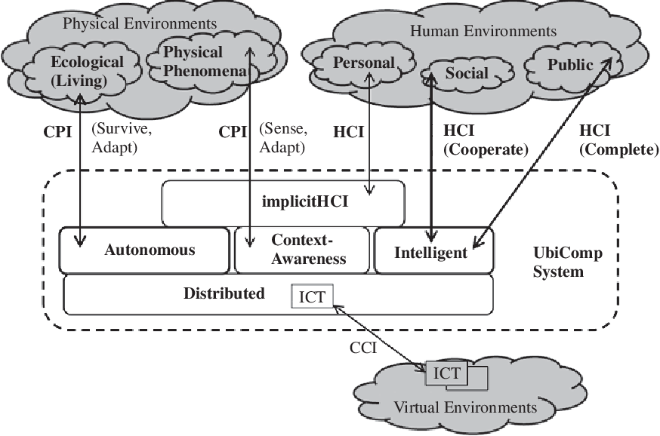
UbiCom System Model

Slide 43
Embodied Reality vs Virtual, Augmented and Mediated Reality
"Embodied reality" and "virtual reality," "augmented reality," and "mediated reality" are terms that describe different aspects of the human experience in relation to technology and the environment.

Slide 44
Embodied Reality
Definition: Embodied reality refers to the perception and experience of the world through the physical body. It emphasizes the importance of the body's presence and its role in shaping one's reality.
Characteristics: The concept highlights the idea that our understanding of reality is deeply rooted in our bodily experiences, sensory perceptions, and interactions with the physical world.
Example: The feeling of warmth from sunlight, the sensation of wind on the skin, or the tactile experience of holding an object are all aspects of embodied reality.

Slide 45
Virtual Reality
Definition: Virtual reality is a computer-generated simulation of an environment that can be interacted with in a seemingly real or physical way. It often involves the use of immersive technologies such as VR headsets to create a synthetic, computer-generated environment.
Characteristics: Users in virtual reality are fully immersed in a computer-generated environment that can be entirely different from the physical world.
Example: Using a VR headset to explore a digitally created space, such as a virtual landscape or a simulated training environment.

Slide 46
Augmented Reality
Definition: Augmented reality involves enhancing the real-world environment by overlaying computer-generated information or digital content onto it. AR blends the physical and virtual worlds, allowing users to interact with both simultaneously.
Characteristics: AR typically uses devices like smartphones, tablets, or AR glasses to superimpose digital information onto the user's view of the real world.
Example: Using an AR app on a smartphone to see information about landmarks when pointing the camera at them or playing an AR game that interacts with the user's surroundings.

Slide 47
Mediated Reality
Definition: Mediated reality is a broader term that encompasses various ways in which technology mediates or alters our perception of reality. This can include both virtual and augmented reality but extends to other forms of mediation as well.
Characteristics: Mediated reality acknowledges that our experience of the world is influenced by various technologies that mediate our senses and perceptions.
Example: Watching a live-streamed event on a screen, using filters on social media apps to alter images, or experiencing a combination of virtual and real elements in an extended reality (XR) environment.

Slide 48
Ubiquitous System Environment Interaction
UbiCom systems focus on integrating computing technology seamlessly into everyday environments and activities. The goal is to create environments where computing is pervasive, but often invisible, enabling natural and context-aware interactions between users and digital resources. Examples: Smart homes, wearable devices, Internet of Things (IoT) applications.
ICT systems encompass a broader range of technologies and applications that facilitate the storage, retrieval, transmission, and manipulation of information. These systems encompass hardware, software, networks, and services used for communication, data processing, and information management. Examples: Enterprise IT systems, telecommunications networks, internet services.

Slide 49
UbiCom System versus ICT System focus
Conventional focus on ICT systems
Systems situated in a virtual world, in an environment of other ICT systems → a system of ICT systems
Conventional use a restrict view of physical environment interaction:
Conventional ICT systems often require humans in the loop
UbiCom represents a powerful shift in computation:

Slide 50
Different Degrees of HCI

Slide 51
Different Degrees of HCI
From less to more C Interaction with H
H2H: human interaction
H2C or explicit (e)HCI:
C2H or implicit (i)HCI:
C2C:

Slide 52
Different Degrees of CPI

Slide 53
Different Degrees of CPI
From less to more C Interaction with P
P2P
Physical interaction (No ICT mediation)
C2P / CA (Physical Env. Context-aware)
C Senses P. C Aware of P’s Context
P2C/AR/MR
C augments or mediates P’s reality.
C actively adapts to P’s context
C2C /VR
Virtualisation of reality facilitated by C

Slide 54
UbiCom System Model: Smart DEI
No single type of UbiCom system: a wide range of applications, technologies, and implementations
Different UbiCom systems support: various functionalities and cater to diverse needs and environments. Example: Context-Aware Systems, Wearable Computing, IoT, Mobile and Pervasive Computing
3 basic architectural design patterns for UbiCom:
smart Devices, smart Environments, smart Interaction
‘Smart’ means systems are:
active, digital, networked, autonomous, reconfigurable, local control of its own resources, e.g., energy, data storage etc.

Slide 55
Smart DEI Model

Slide 56
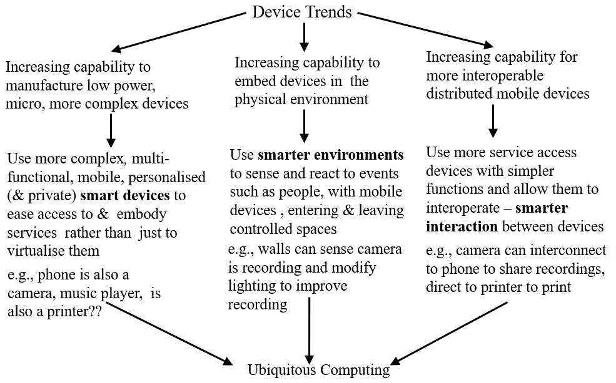
UbiCom System Model: Smart DEI

Slide 57
UbiCom System: Smart Sub-Systems or Components

Slide 58
Smart Devices
Smart devices in Ubiquitous Computing (UbiCom) refer to interconnected and context-aware computing devices embedded within everyday objects and environments.
These devices play a crucial role in creating intelligent and responsive environments that enhance user experiences and automate various tasks.
Example: PC, Mobile Phone, etc.

Slide 59
Smart Device Form Factors
Devices tend to become smaller and lighter in weight, cheaper to produce.
Devices can become prevalent, made more portable and can appear less obtrusive.
Weiser proposed a range of device sizes
Smart Tabs
Smart Pads:
Smart Boards:
Form Factors can be extended to support
Smart Dust
Smart Skins
Smart Clay

Slide 60
Extended Form of Smart Devices
First, ICT devices can be miniaturized without visual output displays, e.g., Micro Electro Mechanical Systems (MEMS), ranging from nanometers through micrometers to millimeters. This form is called Smart Dust.
Second, fabrics based upon light emitting and conductive polymers, organic computer devices, can be formed into more flexible non planar display surfaces and products such as clothes and curtains. MEMS devices can also be painted onto various surfaces so that a variety of physical world structures can act as networked surfaces of MEMS . This form is called Smart Skins.
Third, ensembles of MEMS can be formed into arbitrary three dimensional shapes as artifacts resembling many different kinds of physical object . This form is called Smart Clay.

Slide 61
Smart Mobile Device
One of the most important variants of the smart device is the smart mobile device
Multi-purpose ICT devices, operating as a single portal to multiple services
eases access & interoperability versus decreased openness
Usually personalised devices, specified owner.
Locus of control and user interface resides in the smart device.
Main characteristics: mobility, open service discovery, intermittent resource access.

Slide 62
Smart Devices: Mobility
Mobile devices usually refer to communicators, multimedia entertainment and business processing devices designed to be transported by their human owners, e.g., mobile phone, games consoles, etc.
There is a range of different types of mobiles as follows:
Accompanied: these are devices that are not worn or implanted. They can either be portable or hand held, separate from, but carried in clothes or fashion accessories.
Portable: such as laptop computers which are oriented to two handed operation while seated.
Handheld: devices are usually operated one handed and on occasion hands free, combining multiple applications such as communication, audio video recording and playback and mobile office.
Wearable: devices such as accessories and jewellery are usually operated hands free and operate autonomously, e.g., watches that act as personal information managers.
Implanted or embedded: these are often used for medical reasons to augment human functions, e.g., a heart pacemaker.

Slide 63
Volatile Service Access
Mobiles tend to use wireless networks. However, mobiles may be intermittently connected to either wireless networks (WAN is not always available) or to wired communications networks (moving from LAN to LAN) or to both.
Devices access software services and hardware intermittently . Why?
Because resources are finite and demand exceeds supply.
Devices can dynamically discover services available.
Context-aware discovery can improve basic discovery.
With asymmetric remote service access, more downloads than uploads, tends to occur.

Slide 64
Smart Mobile Devices: Context-Aware
Can use contexts to filter information & service access.
Often designed to work with a reference location in physical environment called a home location,
Mobile devices are ICT resource constrained.
Mobile devices tend to use a finite internal energy cache.
Devices’ configuration, operation tends to be personalised.

Slide 65
Smart Environment
In a smart environment, computation is seamlessly used to enhance ordinary activities.
Consists of a set of smart devices specialised to interact with their (virtual, phys., human) environments.
Typically, embedded single task devices; not MTOS devices
Can automatically respond to or anticipate users, using iHCI
Smart environments support bounded, local user context
Smart environment devices may also be:
fixed versus anchored mobile versus unanchored mobile devices
macro to micro to nano

Slide 66
Types of Smart Environment Device Interaction
Tagging and Annotating : Example – RFID Tags
Sensing & monitoring: Example – Transducers, Sensors
Filtering: Abstraction of features from physical environment
Adapting: Adapting to the features changing in the environment
Controlling: Sensors to determine the state of the physical environment
Assembling: Example – Pre-programmed Robots
Regulating: Example – Regulators in heating system that regulate the temperature

Slide 67
Smart Interaction
Additional type of design is needed to knit together many individual system components and interactions.
Smart interaction promotes unified & continuous interaction model between UbiCom applications & their UbiCom infrastructure, physical world & human environments.
System can be internally self-organising system vs. externally driven system.
Components can interact cooperatively or competitively to achieve the goal.
Several benefits to designs are there based upon set of interacting components.
A range of levels of interaction between UbiCom System components from basic to smart.

Slide 68
Basic Interaction
Typically involves two interlinked parties, a sender and a receiver.
Sender knows things in advance:
Two main types of basic interaction synchronous versus asynchronous

Slide 69
Smart Interaction
Smart Interaction extends basic interactions as follows.
Coordinated interactions
Cooperative versus competitive interaction
Policy and Convention based Interaction
Dynamic Organisational Interaction
Semantic and Linguistic Interaction

Slide 70
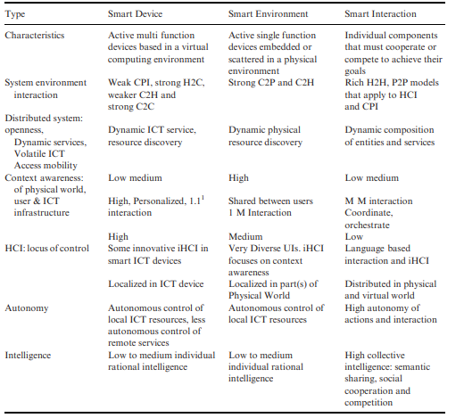
Comparison of smart device, smart environment and smart interaction

Slide 71
Common Myths of Ubiquitous Computing (1/2)
There is a single definition which will accurately characterises Ubiquitous Computing
The ideal type of Ubiquitous computing is where all the properties of ubiquitous must be fully supported
Ubiquitous computing means making computing services accessible everywhere.
Ubiquitous computing is boundless computing
Ubiquitous computing is just about HCI
Calm Computing should be used as a model for all HCI.
Ubiquitous computing is just about augmenting reality
Notes:
Calm Computing is a concept that aims to create technology experiences that are unobtrusive, non-disruptive, and supportive of well-being and mental health. Coined by Mark Weiser and John Seely Brown in the late 1990s, the term is a response to the increasing prevalence of technology in daily life and the potential for it to cause stress, distraction, and information overload.

Slide 72
Common Myths of Ubiquitous Computing (2/2)
Ubiquitous computing is just distributed or virtual computing
Ubiquitous computing is just mobile wireless computing
Ubiquitous computing is just about smart environments
Ubiquitous computing need to be highly autonomous systems
Ubiquitous computing is just about physical world context-awareness
Ubiquitous computing is just distributed intelligence
Ubiquitous computing systems can operate effectively in all kinds of environments:

Slide 73


